Slide 1
Eugene and Springfield Demographics
By: Ali Carmichael
ADS4SJ

Slide 2
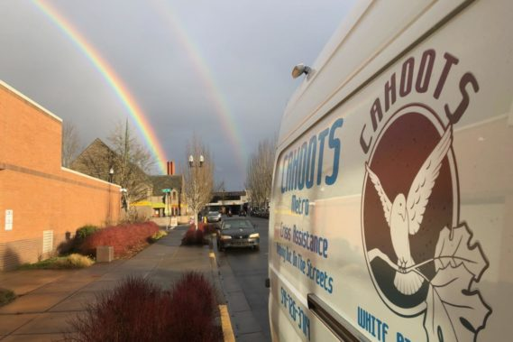
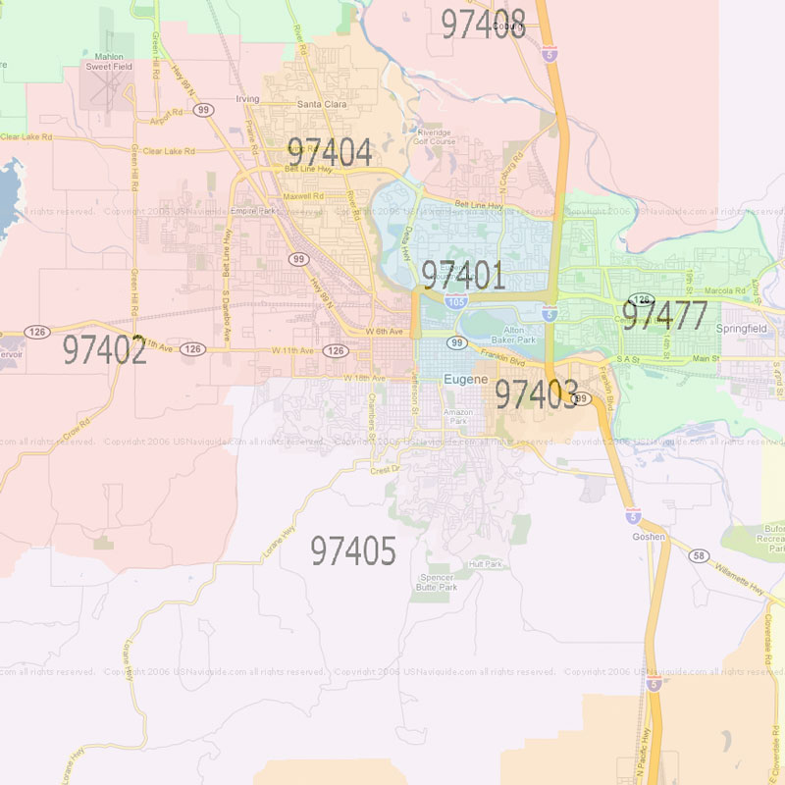

Background
CAHOOTS calls from 11 different zip codes
Four different demographic groups: age, income, education, and race.
CAHOOTS (Crisis Assistance Helping Out On The Streets)
Notes:
Service in Eugene stopped April 7th 2025
Springfield van still in service
Most calls are from 97401
Springfield only has three zip codes
Police public assist (97401, 97402) most common
Welfare and transportation second most common

Slide 3


Research Questions
What populations is CAHOOTS serving?
How do these populations differ between Eugene and Springfield?

Slide 4

Data
Call Data
Call_City
Responding_Unit
Call_Zipcode
97401
cahoots
Eugene
cahoots
97477
Springfield

Slide 5

Data
Demographic Data
97402
97401
Income table example
Less than $10,000
2435
1374
1481
$10,000 to $14,999
1273

Slide 6


Methods
What populations is CAHOOTS serving?
Calls per 1000 people
Variable correlations
Create call volume quartiles and calculate averages
Call volume by zip code

Slide 7


Methods
How do these populations differ between Eugene and Springfield?
Calls per 1000 people
Classify entries by city function
Chi squared test function
Call volume by zip code

Slide 8
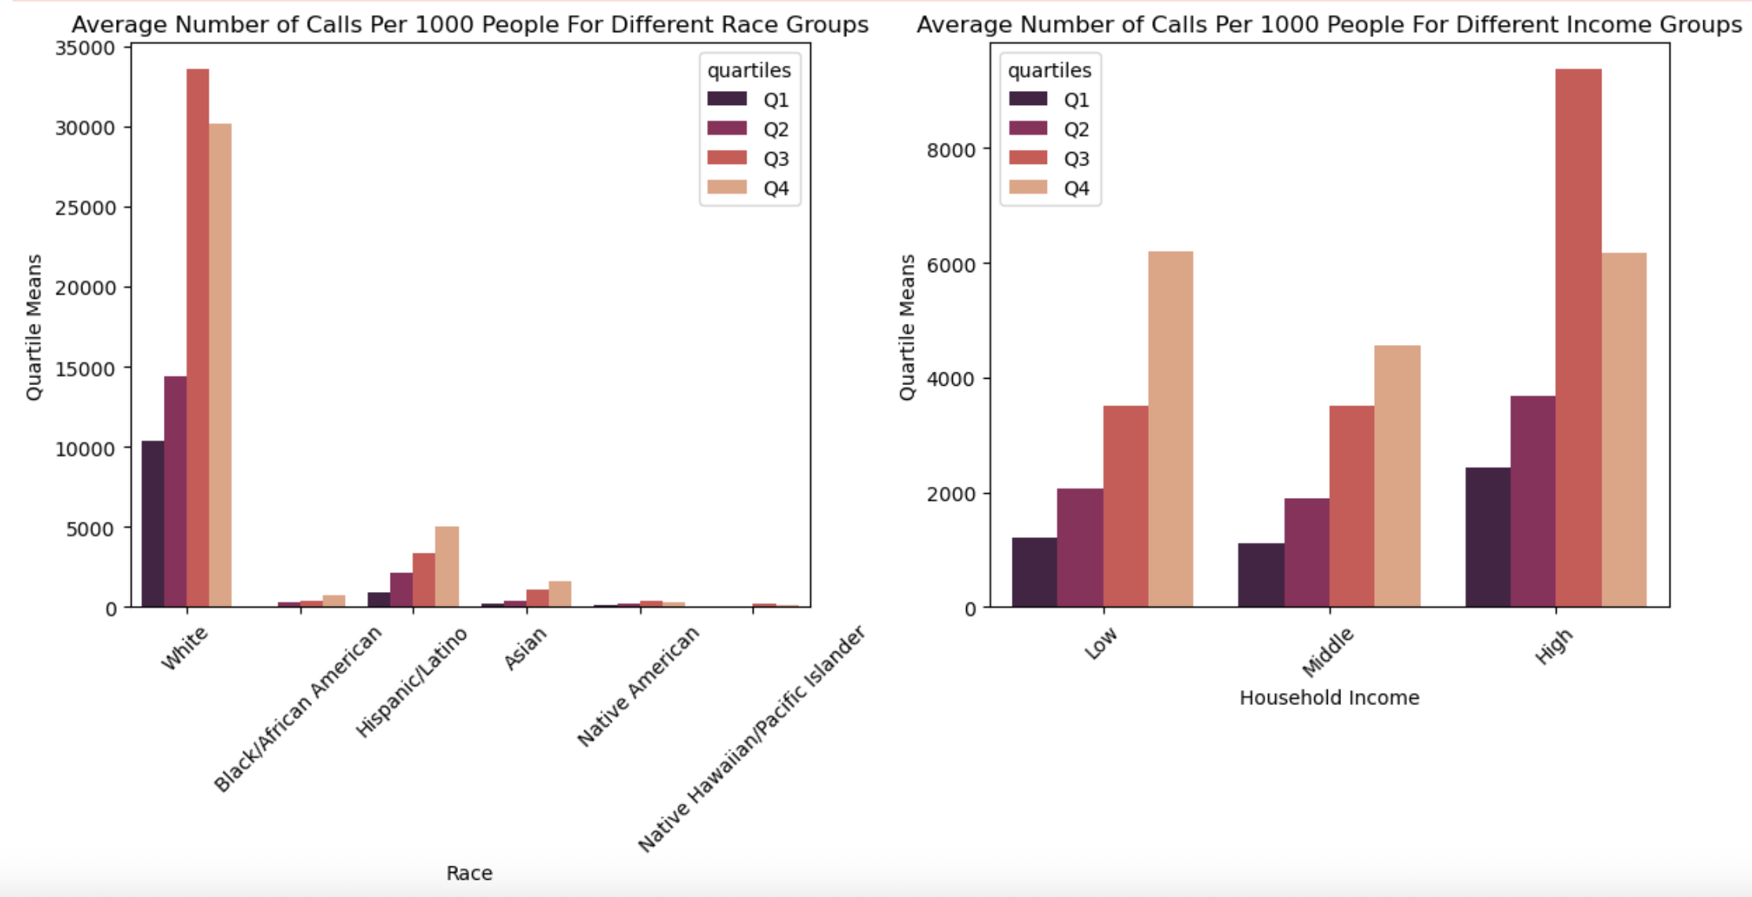

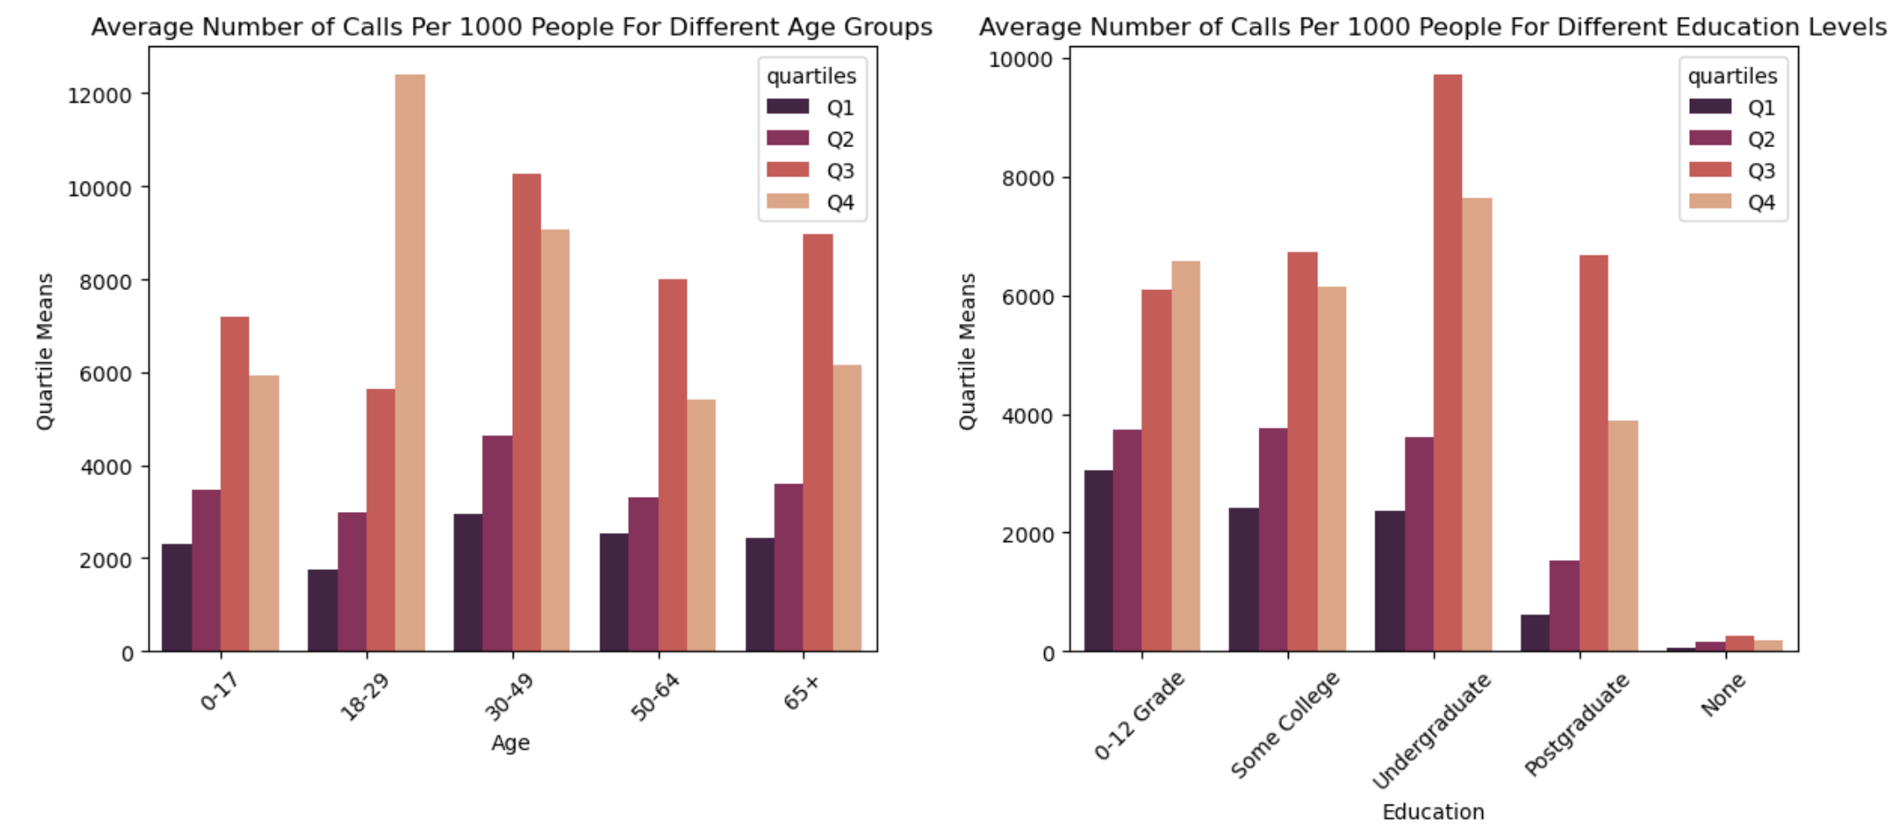
Results

Slide 9

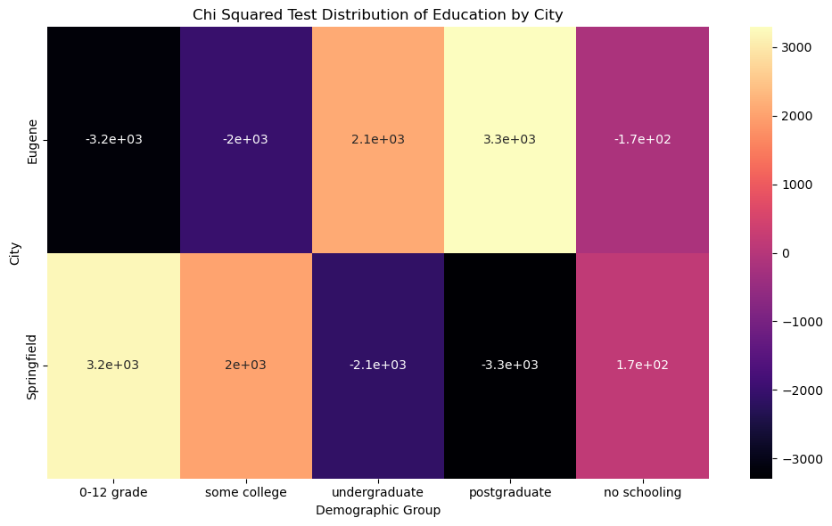
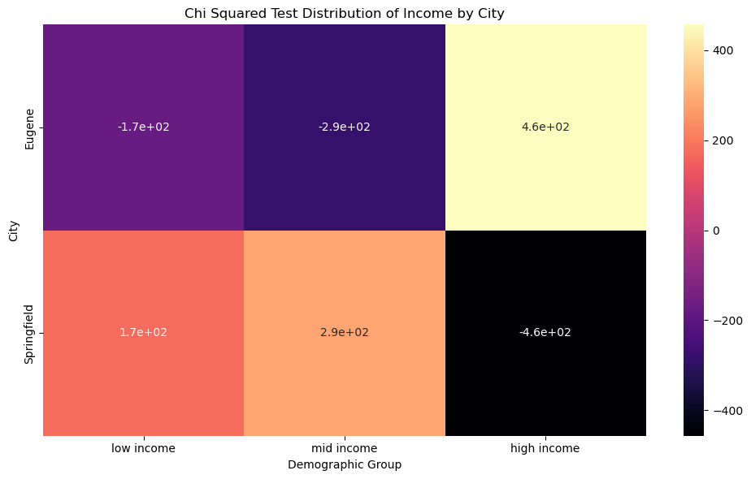
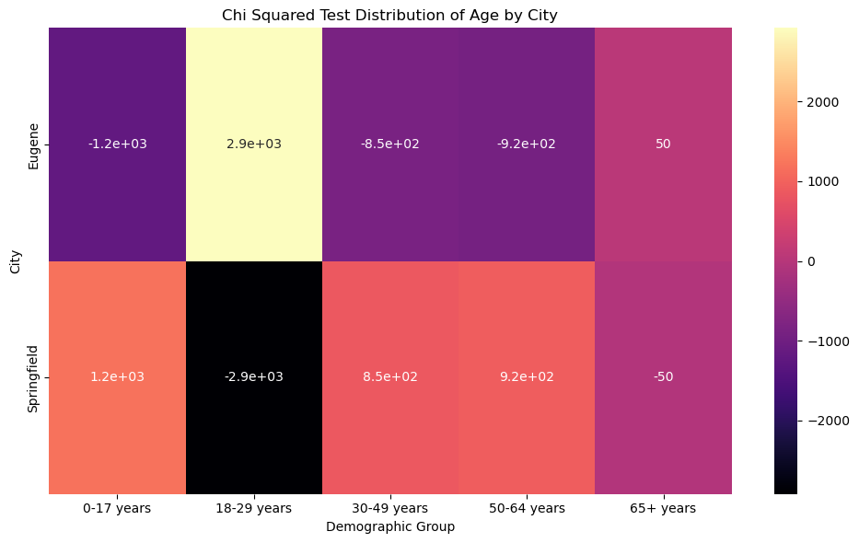
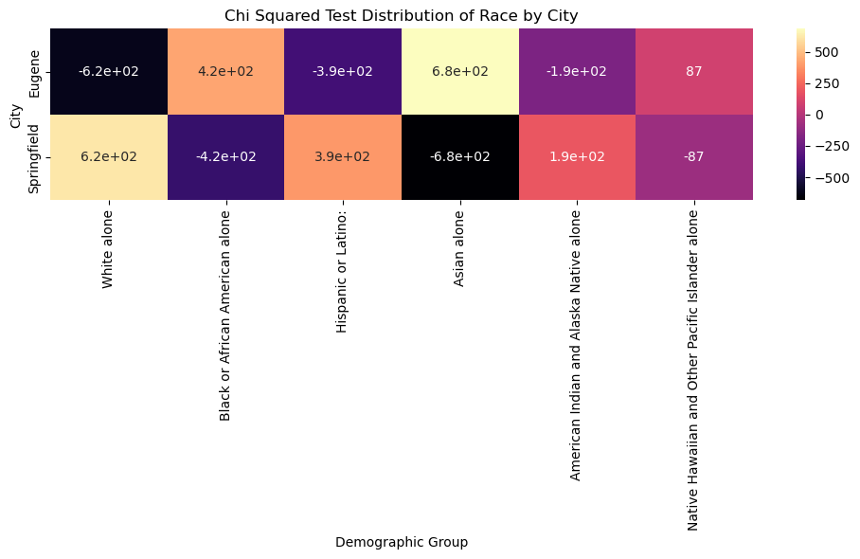
Results

Slide 10

Discussion
18-29 age group has the highest call rate in high-call areas and Q4 is relatively consistent across all demographics
Many demographic groups are severely underrepresented in both Eugene and Springfield.
Call type and demographics?
There are more zip codes for Eugene than Springfield
Demographic data is not directly related to call data

Slide 11

Acknowledgments
CAHOOTS
Rori Rohlfs
&
Eli
ADS4SJ Team

